Slide 1
Fueling An Athlete
Melissa Allen, RD
Performance Dietitian CSCA
Melissa Allen, Food and Nutrition

Slide 2
Plan of Attack!
Why is food important?
Training- fueling connection
Meal and School Lunch Ideas
Pre/post training snack ideas

Slide 3
Food is Fuel

Slide 6
Training Intensity- Fueling Needs

Slide 10
Meals / School Lunches Ideas

Slide 11
Easy, Inexpensive Meal Ideas
Breakfast
Greek yogurt + fruit
Toasted waffle + nut butter + jelly (fold in half and it’s portable)
Breakfast burrito with scrambled eggs, cheese, salsa and tortilla
Overnight oats (made with milk/soy) + fruit
Egg Muff-lettes (egg/veggie/cheese omelets baked in muffin tins) & toast with jam

Slide 12
Easy, Inexpensive Meal Ideas
Lunch/Dinner
Tuna + veggie + low-fat ranch dressing in a tortilla roll-up
Mediterranean pita with chicken, cucumbers, tomatoes and Greek dressing
To-salads: cooked protein, pasta or rice, veggies and low-fat dressing, packed in a lidded cup
Rice or quinoa bowls with sautéed shrimp and veggies
Bean and cheese quesadillas with salsa

Slide 14
Easy, Inexpensive Meal Ideas
Snacks
Nut Butter Dunk – microwave nut butter until melted and dunk in apple chunks
Hummus and veggies/pita chips
Frozen yogurt + fruit ice pops
Fresh fruit kebabs with yogurt dip
Baked tortilla chips with taco-seasoned cooked ground turkey, cheese and salsa

Slide 15
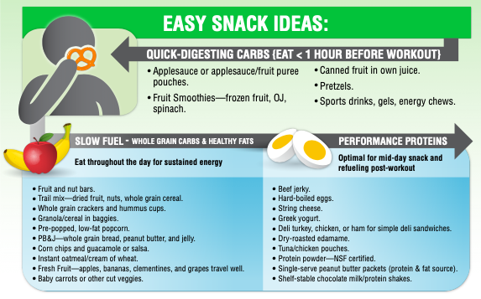

Slide 16
Fuel to Have on Hand
Beans/Legumes/Nuts
black beans- canned
cannellini beans- canned
garbanzo beans- canned
northern white beans – canned
kidney beans- canned
dried lentils
peanut butter or other nut butter
nuts: almonds, walnuts, pecans & pistachios
Frozen Food
frozen fruit- for smoothies, etc
frozen vegetables
frozen grilled chicken/beef strips
frozen shrimp
soups/stews- to defrost & reheat
Grains/Pasta/Starches
pasta
brown rice
couscous
quick cook polenta
quick cook grits
wholegrain bread
pita
tortillas: corn or flour
potatoes: sweet or white
oatmeal
quinoa
granola bars

Slide 17
Fuel to Have on Hand
Refrigerated Items
eggs
milk/milk alternative
cottage cheese
hummus
veggies: carrots, cucumber & lettuce
fruit: apples, grapes & melon
Greek/skyr yogurt
Low-fat sour cream
cheese: parmesan, jack, mozzarella & cheddar
fresh herbs: basil/cilantro
Drinks/Protein Bars/ Gels
water
100% fruit juice
milk (whole, 2%, 1%, skim, soy, almond)
Sport drinks
tea, coffee
Canned Goods
tomatoes
broth
beans
marinara sauce
tuna
salmon
fruit: pineapple, pears, etc.
Countertop Items
tomatoes
bananas
fruit needing ripening

Slide 19
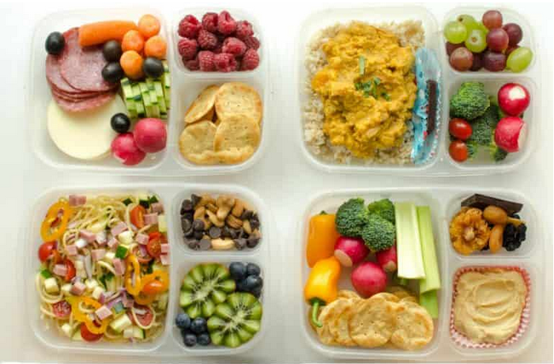

Slide 20
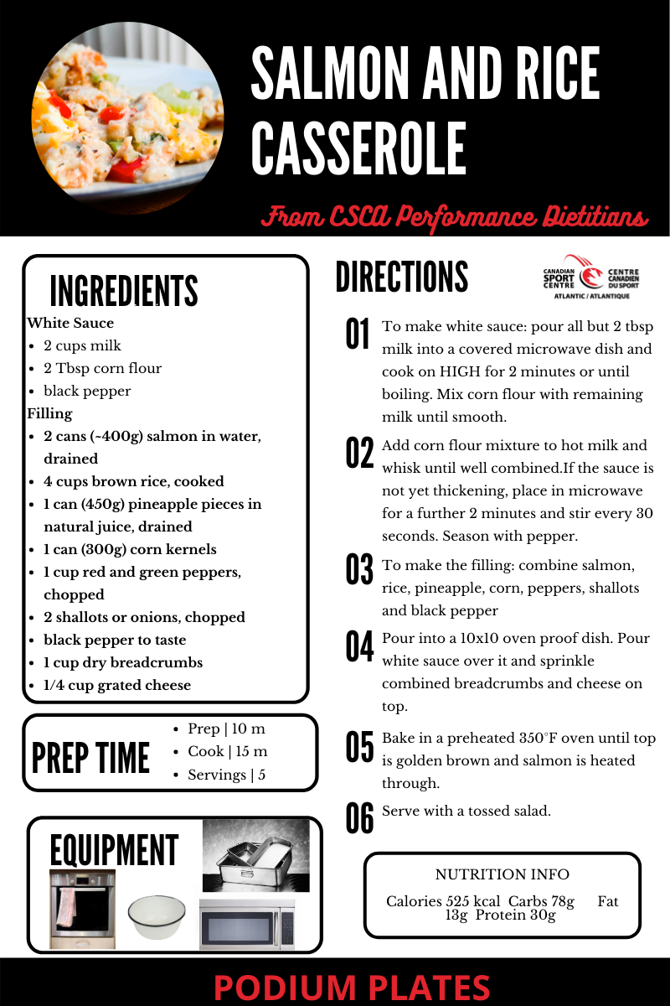
Great Recipes Sources!
Fitmen Cook
https://fitmencook.com/
Australian Institute of Sport Recipes
https://ais.gov.au/nutrition/recipes
Cookspiration
https://www.cookspiration.com/
CSCA Resource Hub
https://cscatlantic.ca/resource-hub
Supercook
https://www.supercook.com/#/recipes

Slide 21
Pre/Post Training Snack Ideas

Slide 22
Nutrition Before Training

Slide 23
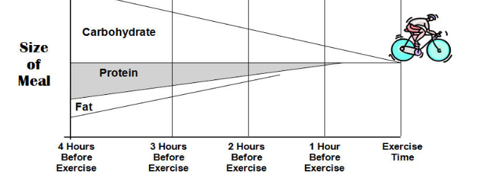
Pre-Workout Nutrition
Carbohydrate-rich (1-4g/kgBM)
Consumed 1-4 hours before the event
Low fibre, low fat, low-moderate protein
300-600ml water

Slide 24
PRE-WORKOUT NUTRITION
Eat a combination of foods high in carbs and moderate in protein
Focus on foods low in fat and fibre
Length and intensity of workouts matter
6 am workout? Fuel well the night before and eat something small in the morning
Experiment in practices to figure out what works best.

Slide 25
Nutrition After Training

Slide 26
Recovery Nutrition Timeframe
Rehydrate
As soon as possible!!
Protein/ Carbs
Body most effective at replacing carbs and rebuilding muscles in first 1-1^{1/2} hr
Will continue to for ~12-24hr though
Back to back or 2 sessions a day
Maximize recovery in first 1-1^{1/2}hr
24 hrs or longer
Regular meals/snack can be recovery nutrition
Can split recovery by having small snack right after and then eat next main meal
Notes:
When energy needs are high, the athlete may undertake ‘recovery eating’ immediately after each training session as an additional opportunity for intake in the day as much as for any benefits of speedy intake of nutrients after exercise. A pattern of small, frequent meals over the day may assist the athlete to achieve high energy intakes without the discomfort of overeating
Recovery snacks should not contribute additional energy to a restricted energy budget. Rather, when rapid recovery is desirable, the energy-restricted athlete should change the timing of their existing meal structure to allow for immediate intake after exercise sessions. One option is to reschedule training sessions or meals so that the athlete is able to eat their normal meal as soon as possible after the workout. Where this is not practical, the athlete may be able to take a small snack from within their usual meal plan to consume immediately after training or as a pre-resistance-training snack (e.g. fruit and flavoured yoghurt usually consumed as a dessert with dinner), then consume the remainder of their meal at the usual time.

Slide 27
Recovery Targets
Carbohydrates
1-1.2 g/kg/hr, first 1 hr
Soon after exercise
Hydration
~125-150% of deficit from exercise in next 2-4 hrs
Replace electrolytes
Added electrolytes or salt-rich foods
Protein
20-35g
Soon after exercise
Consider the quality and AA's
Remember optimal protein is 20-35g every 3-4 hrs
Notes:
Carb Benefits
Maximises muscle fuel for the next demanding workout or event
When should pro-active refuelling be practised?
After races or fuel-depleting training sessions when the athlete is backing up for the next session in 8 hours or less
When total fuel needs are high: high-volume training, demanding competition schedule (e.g. cycling tour, tennis tournament)
Protein Benefits
Maximizes muscle protein synthetic response to exercise to promote adaptations to the training stimulus. Note that the elevated response lasts at least 24 hours
When should pro-active protein nutrition be practised?
After competitive events or key training sessions (resistance sessions, high-intensity sessions) in which there is a major exercise stimulus or muscle damage
When gains in muscle mass and size are a priority

Slide 29
Proactive Refueling
Food sources of high-quality protein (providing ∼10 g protein):
2 small eggs
25 g skim milk powder
300 mL milk (full fat, reduced fat, skim)
30 g (1.5 slices) of reduced fat cheese
70 g cottage cheese
200 g low-fat fruit yogurt
35 g lean beef, lamb or pork (cooked weight)
40 g lean chicken (cooked weight)
50 g grilled fish or canned tuna/salmon
120 g tofu or soy ground
400 mL soy milk
Sports foods/supplements providing 10 g protein include:
15–20 g high-protein powder or protein hydrolysate
120–150 mL liquid meal supplement
20–30 g high-protein sports bar
Rapidly digested protein sources (liquid based, high in whey) that are particularly suitable for a post-exercise protein boost include:
milk, flavored milk, milk shakes, smoothies, yogurt
whey-based protein drinks or liquid meal supplements
Carbohydrate-rich selections include:
breads (including rolls, wraps, bagels, muffins)
cereals (porridge, packaged cereals and muesli)
grains (rice, pasta, noodles, quinoa and couscous)
sweetened dairy (flavored milk, flavored yogurt)
fruits, starchy vegetables (potatoes) and legumes
Mix and match these items into meals such as:
cereal with fruit
sandwiches/rolls/focaccia/wraps/pizza
fruit smoothies (blended fruit, milk and yogurt)
meals served with grains (curry and rice, pasta with sauce, stir fry with noodles) or where the grain is a major ingredient (pasta bake, risotto, paella)
Compact forms of CHO
sports drinks, liquid meals, gels and bars
jam, honey and other sugary toppings
juices and soft drinks

Slide 30
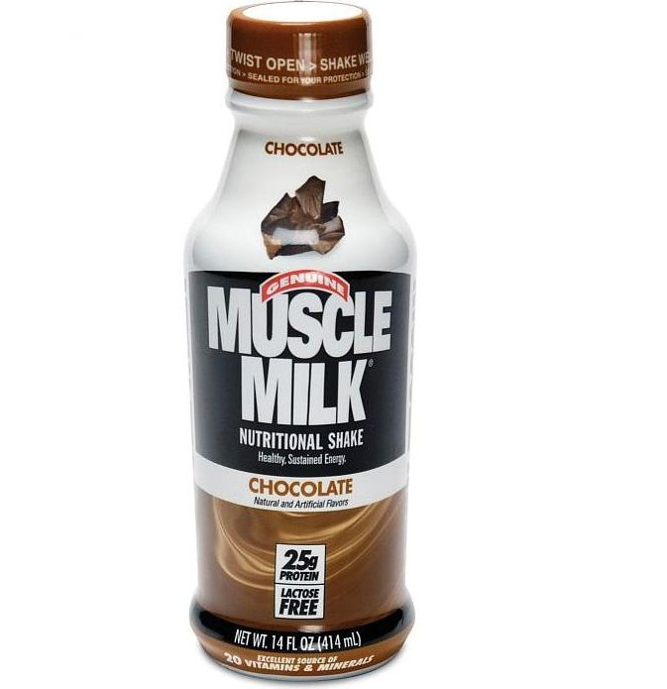
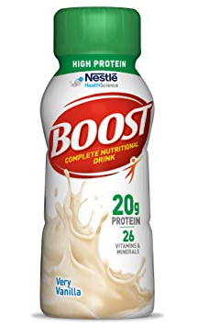
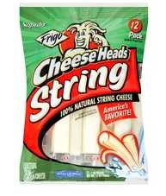
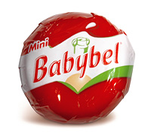
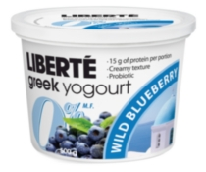
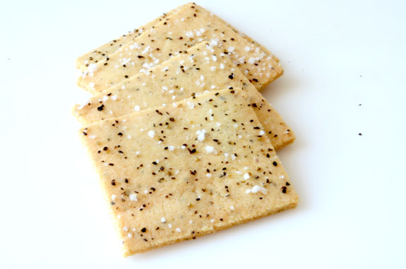
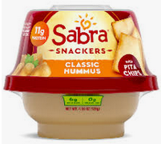
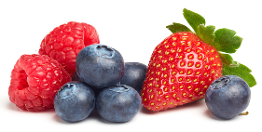
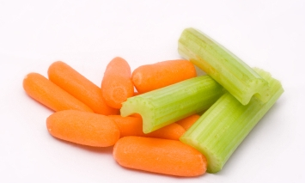
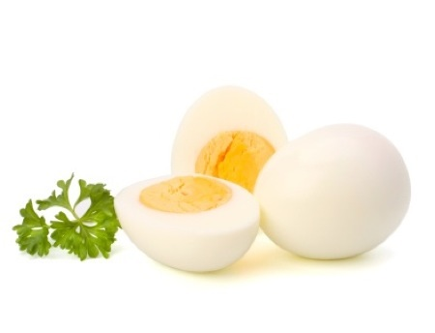
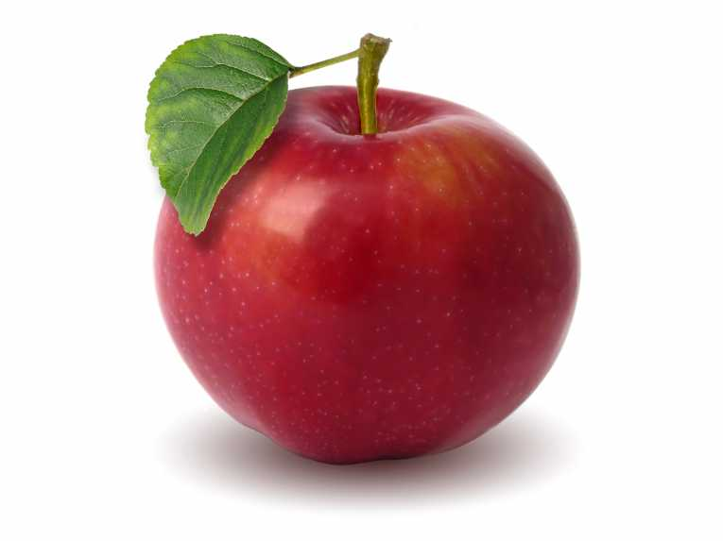
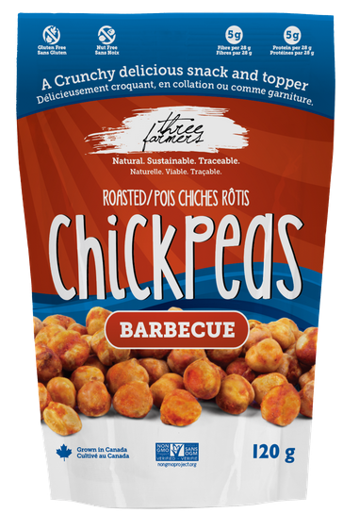
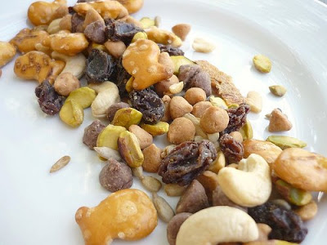
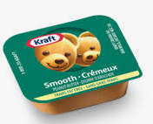
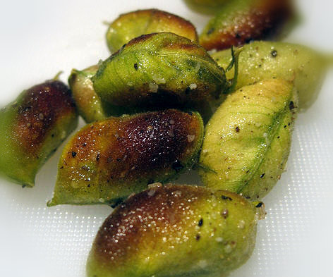
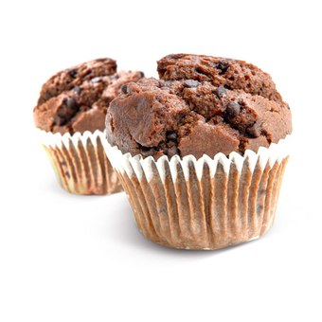
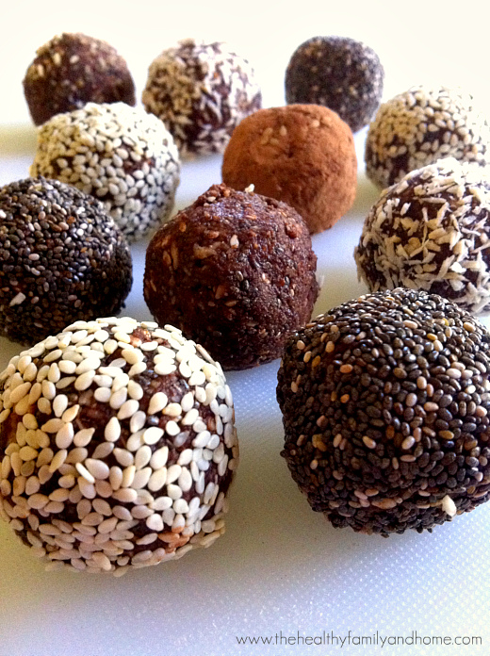
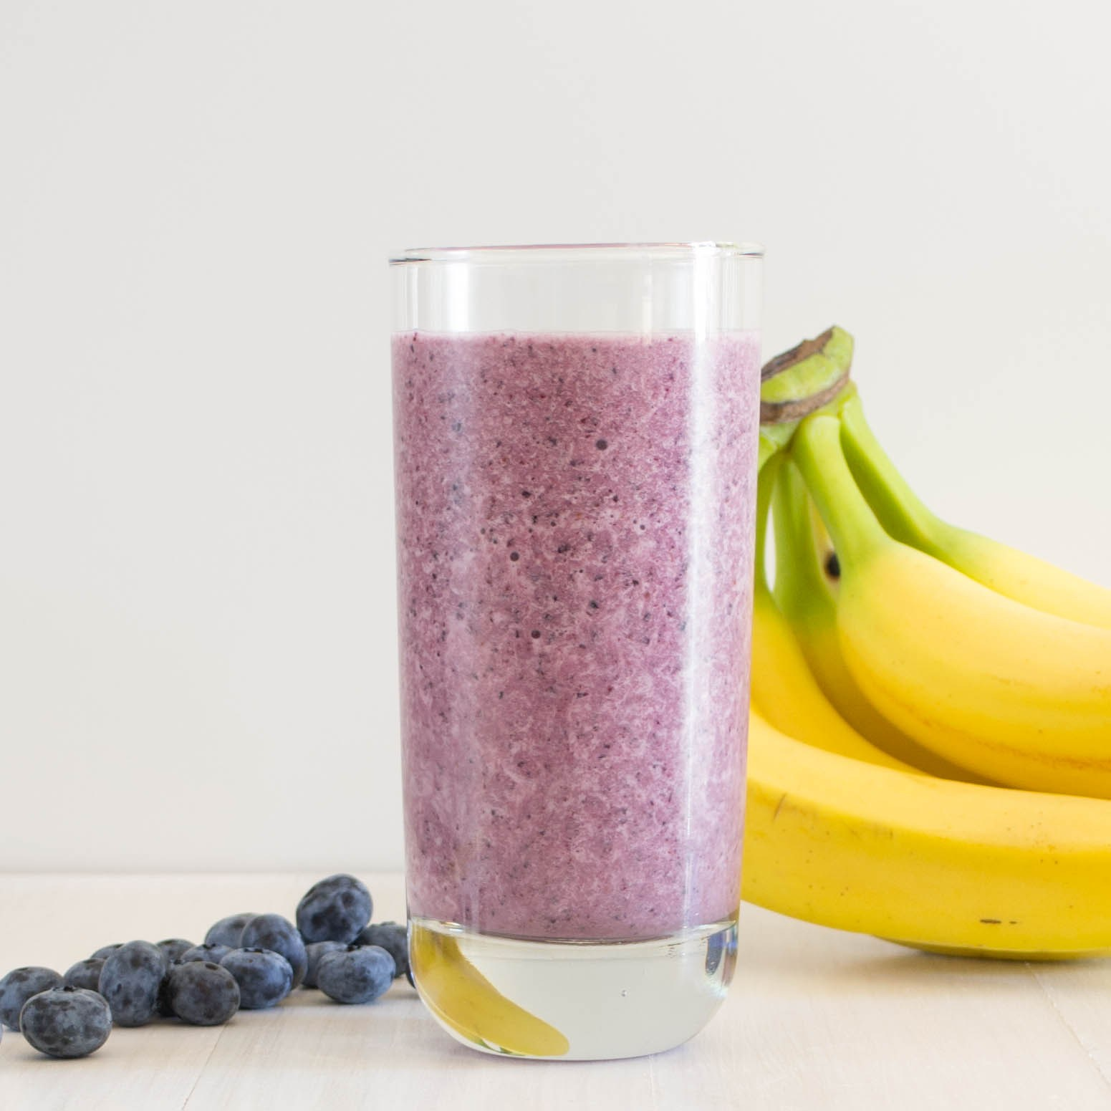
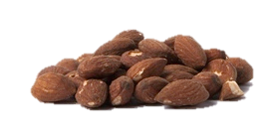
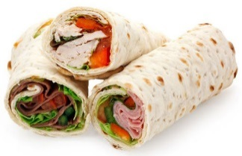
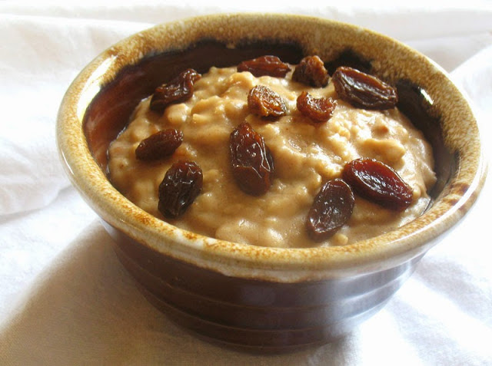
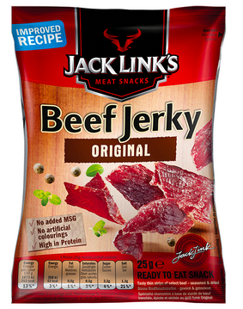
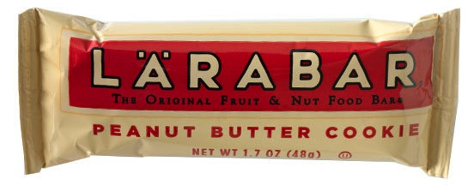
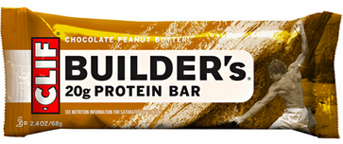
Quick, Easy Recovery Snacks
Roasted Chickpeas
Greek yogurt & fruit
Crackers & Hummus
Veggie sticks & boiled eggs
Trail Mix
Homemade muffins
Banana & nuts
Oatmeal & Fruit
Fruit/nut Bars

